Slide 1

Relations, Functions, and Matrices
Mathematical Structures for Computer Science
Chapter 5
Copyright © 2014 W.H. Freeman & Co. MSCS Slides Section 5.5

Slide 2
Order of Magnitude of Functions
Order of magnitude is a way of comparing the “rate of growth” of different functions.
For instance, if we compute f (x) = x and g(x) = x² for increasing values of x, the g-values will be larger than the f-values by an ever increasing amount.
This difference in the rate of increase cannot be overcome by simply multiplying the f-values by some large constant.
Section 5.5
Order of Magnitude

Slide 3
Order of Magnitude of Functions
DEFINITION: ORDER OF MAGNITUDE
Let f and g be functions mapping nonnegative reals into nonnegative reals. Then f is the same order of magnitude as g, written f=Θ(g), if there exist positive constants n₀, c₁, and c₂ such that for x ≥ n₀, c₁ g(x) ≤ f (x) ≤ c₂ g(x).
Note: f = Θ(g) is read as “f is big theta of g”
Two functions of the same order of magnitude grow at roughly the same rate.
Section 5.5
Order of Magnitude

Slide 4
Order of Magnitude of Functions
For example, if f(x) = 3x² and g(x) = 200x² + 240x + 7, then f = Θ(g) = Θ(x²).
  A polynomial is always the order of magnitude of its highest-degree term;
  lower-order terms and all coefficients can be ignored.
Order of magnitude is important in analysis of algorithms.
We identify the important operations the algorithm performs.
  Usually the number of times such operations must be done in executing the algorithm will depend on (be a function of) the size of the input.
Section 5.5
Order of Magnitude

Slide 5
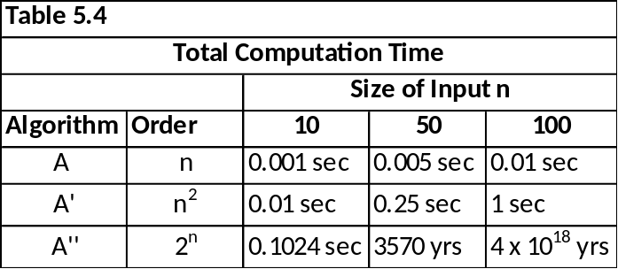
Order of Magnitude of Functions
  The order of magnitude of an algorithm is known as its “computational complexity”
    The higher the order of magnitude the higher complexity one must deal with because it reflects the inherent amount of work in the algorithm.
  Evaluating the effect of the growth of n on the order of magnitude
    3 Algorithms:
      A is Θ(n)
      A’ is Θ(n²)
      A’’ is Θ(2^{n})
  Note even with each computational step taking 0.0001 second or less, the exponential case grows at a fantastic rate!
  Algorithms not of polynomial order are generally not useful for large values of n.
  Problems for which no polynomial time algorithms exist are called intractable.
Section 5.5
Order of Magnitude

Slide 6
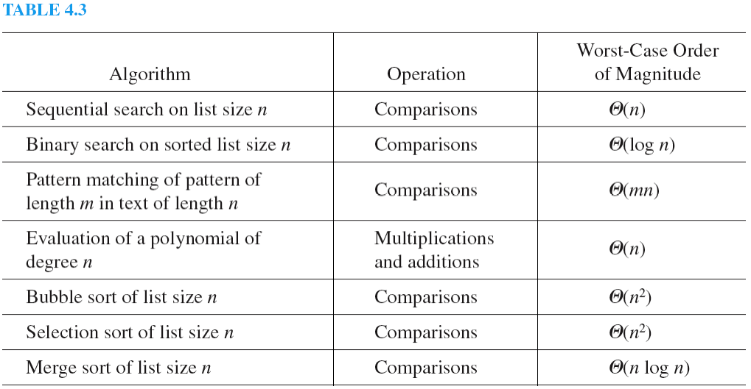
Analysis of Algorithms
Rather than compute the exact function for the amount of work done, it is easier and often just as useful to settle for order-of-magnitude information.
Below is a summary of the worst-case order of magnitude for algorithms discussed in Section 3.3.
Click
Here
Click Here
Click Here
Section 5.5
Order of Magnitude

Slide 7
Order of Magnitude of Functions
DEFINITION: BIG OH
Let f and g be functions mapping nonnegative reals into nonnegative reals. Then f is big oh of g, written f = O(g), if there exist positive constants n₀ and c such that for x ≥ n₀, f (x) ≤ cg(x).
If f (n) represents the work done by an algorithm on an input of size n, it may be difficult to find a simple function g such that f = Θ(g).
We may still be able to find a function g that serves as an upper bound for f.
  In other words, while f may not have the same shape as g, f will never grow significantly faster than g, that is, f = O(g).
  See Graphs in figures 5.25, 5.26 and 5.27 on page 414 of textbook
Section 5.5
Order of Magnitude

Slide 8
Order of Magnitude of Functions
The big oh notation f = O(g) says that f grows at the same rate or at a slower rate than g.
If we know that f definitely grows at a slower rate than g, then we can say something stronger.
This is the little oh of g, written f = o(g).
The relationship between big oh and little oh is this: If f = O(g), then either f= Θ(g) or f = o(g).
Section 5.5
Order of Magnitude

Slide 9
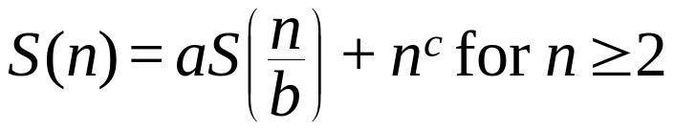
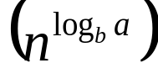
Master Theorem
DEFINITION: Master Theorem
Consider the recurrence relation
S(1) ≥ 0
where n = b^{m}, a and b are integers, a ≥ 1, b > 1, and c is a nonnegative real number. Then
if a < b^{c} S(n)=Θ(n^{c})
if a = b^{c} S(n)=Θ(n^{c} log n)
if a > b^{c} S(n)=Θ
n - represents the size of the problem (work to be done)
n/b - represents the size of each sub-problem (assumed to be equal)
a - represents the number of sub-problems in the recursion
For more information click
_{Here}
Section 5.5
Order of Magnitude

Slide 10
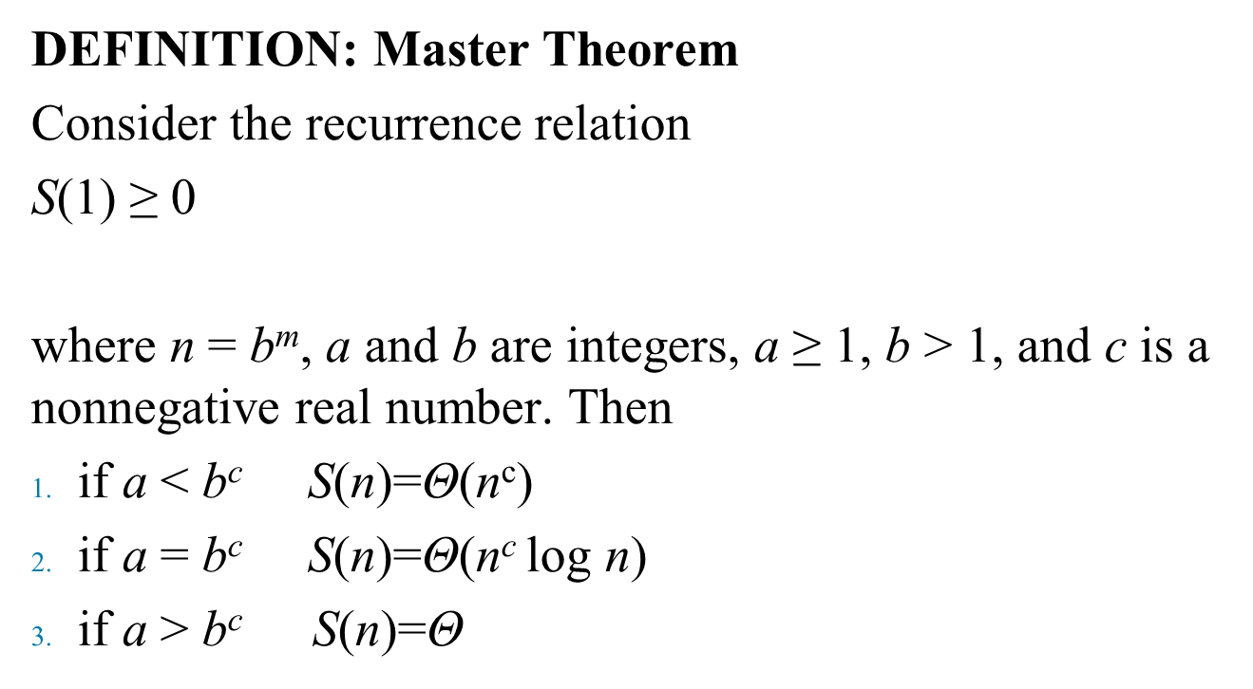
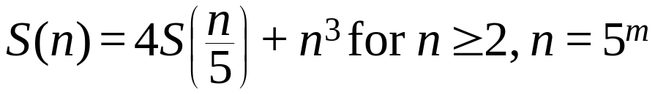
Master Theorem Example
A recurrence relation of the form
matches the form of recurrence relations shown in the
Master Theorem with a = 4, b = 5 and c = 3
Because 4 < 5³, Case 1 applies and the Master Theorem says that S(n) = Θ(n³).
  Master Theorem does not give exact solutions, but order of magnitude results.
  The value of S(1) (a constant) plays no part in determining the result.
Section 5.5
Order of Magnitude

Slide 11
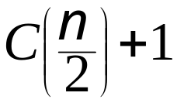
Master Theorem Example
The worst-case recurrence relation for comparisons done by the binary search algorithm on a sorted list of size n is
C(1) = 1
C(n) = for n ≥ 2, n = 2^{m}
We previously found the exact solution for this recurrence relation to be C(n) = 1 + log n, certainly Θ(log n).
We can find this directly from the Master Theorem with a = 1, b = 2, c = 0. Because a = b^{c}, (Case 2)
C(n)= Θ(n⁰log n) = Θ(log n).
Section 5.5
Order of Magnitude

